Slide 1
Supplier Management Problem
Yashwanth Raj Varadharajan (G47635180)

Slide 2
Problem Statement
To maintain a steady supply of goods, the grocery store needs to manage its relationships with suppliers. Each supplier provides different types of products, and the store needs to keep track of supplier names, contact information, and the products they supply. Design a data model to represent the relationship between suppliers and the products they supply to the store. You will write applications to order from suppliers and to maintain the supplier table.

Slide 3
Requirements
Each Supplier supplies different products.
Store needs to track Supplier Name, contact information and products they supply.

Slide 4
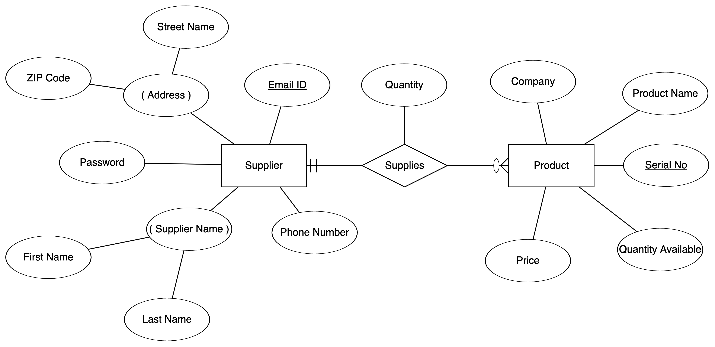
Chen ERD

Slide 5
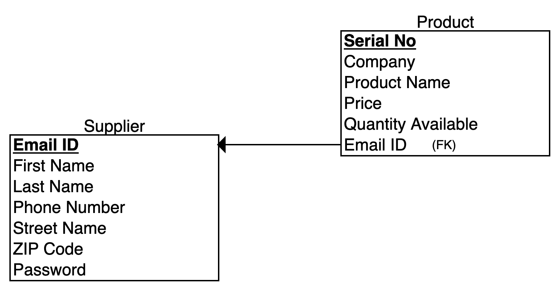
Relational ERD

Slide 6
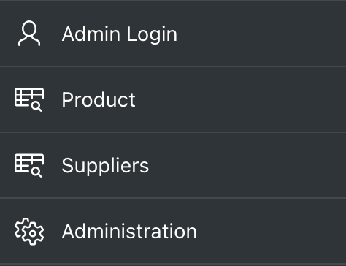
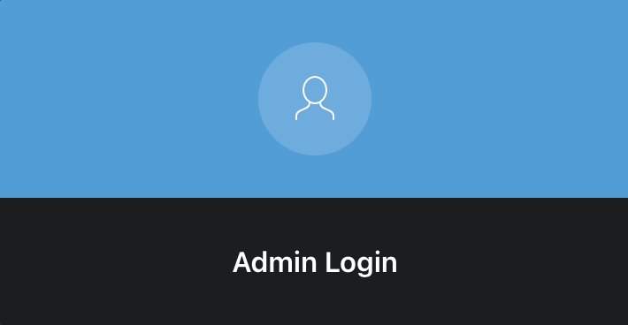
Apex App Basic Structure

Slide 7
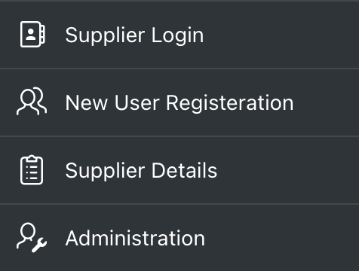
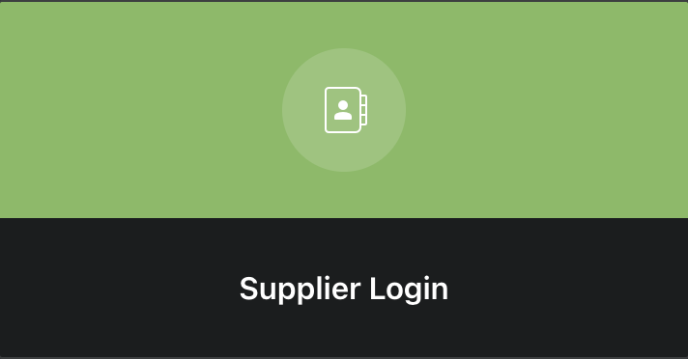
Apex App Basic Structure

Slide 8
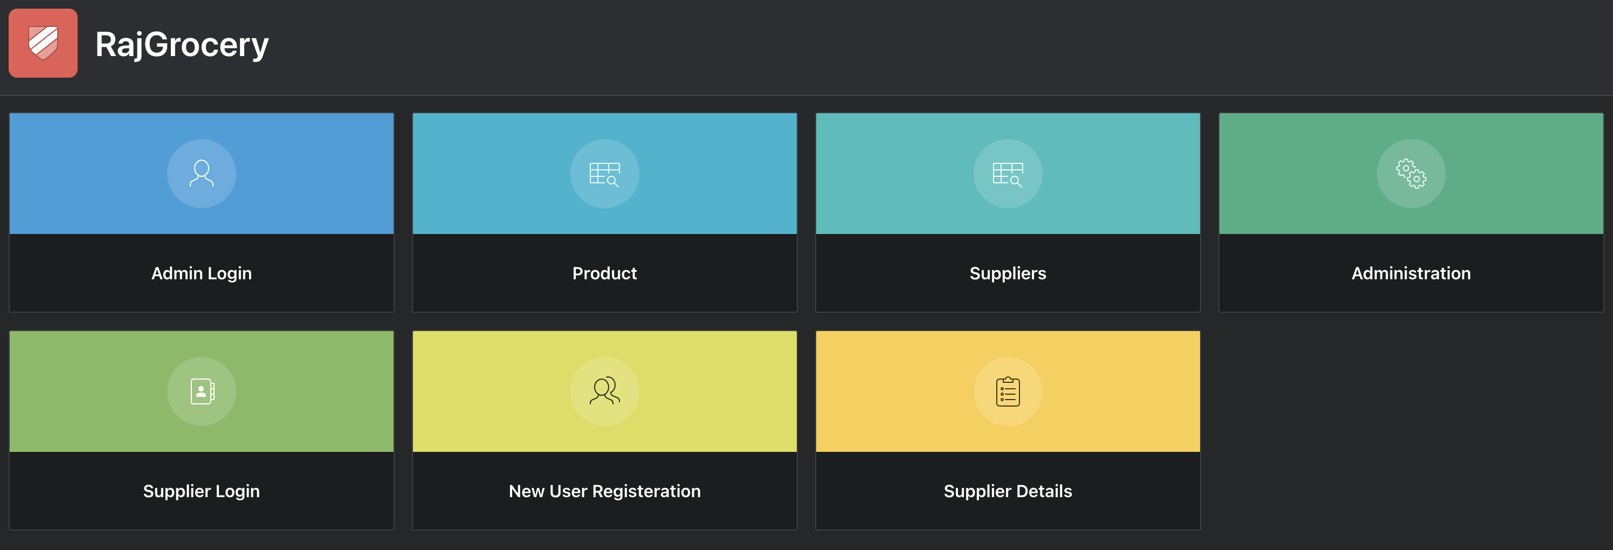
Apex App
App Link - https://apex.oracle.com/pls/apex/r/csi6441_colloquium/rajgrocery/login?session=10463288518074

